Slide 1



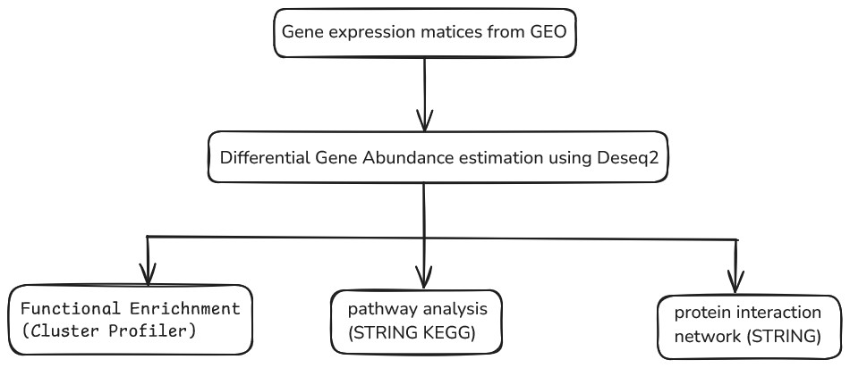
Investigating Candidate Genes involved in Esophageal Cancer through Integrated Transcriptomics Data Analysis
Emmanuel Aroma, Patriciah Kinyua, Wafaa M Rashed, Emmanuel Asiimwe, Tayyiba Amartey, Faith Adegoke, Andrew Aladele, Olajire Gershom, Yusuf Eshimutu Abu, Kwame Boamah Buabeng, Sadock Mboya, Mark Tefero Kiumbi, Michal Zulcinski, Eva Akurut, Omnia Abdelnasser, Esra A. Abdalwhab
1 Mbarara University of Science and Technology, Mbarara Uganda
2 Makerere University, Kampala Uganda
3 Pwani University, Kilifi Kenya
4 CEMA Nairobi Kenya
Background
Esophageal cancer remains a significant global health challenge, with high morbidity and mortality rates. Through this project, we hope to contribute to the development of precision medicine strategies for esophageal cancer, ultimately improving patient outcomes and advancing the field of cancer research.
To address this, our project aims to identify and investigate candidate genes involved in esophageal cancer through integrated transcriptomics approach to identify differentially expressed genes between esophageal cancer and normal tissues.
We will explore the functional relationships and interactions among these molecular entities, aiming to uncover novel therapeutic targets and drug-gene interactions. We will utilize public repositories such as TCGA and GEO to gather diverse datasets encompassing various stages and subtypes of esophageal cancer.
Aim and objectives
General Objective
Identify novel candidate genes associated with epilepsy using integrative transcriptomic data analysis.
Specific Objectives
Identify differentially expressed genes (DEGs) between patients with esophageal cancer and healthy controls.
Perform functional enrichment analysis to identify genes that are involved in related biological pathways and protein interaction networks.
Methodology
References
ALDH18A1promotes the tumor progression of esophageal cancer by binding to and regulating genes associated with tumorigenesis.
The aberrant inclusion of BOLA3 exon 3 promoted by HNRNPC acts as an oncogenic driver in esophageal squamous cell carcinoma.
RBM4 regulates esophageal cancer progression.

